Slide 1
RAGSY-CODE TO VISUALIZER
Presentation By :
RANJANBABU .V : NEC0823004
YOGESH .S : NEC0823014
SHWETHA .A : NEC0823029
GOUTHAM .S : NEC0823105
AKLIMA BEGUM SARA : NEC0823115

Slide 2
INTRODUCTION
The Code to Visualizer (Ragsy) is a web-based application that converts Programming language code into interactive flowcharts to simplify understanding of program logic.
It helps the users to visualize execution flow easily, making learning and debugging more efficient.
The system also includes secure authentication and activity tracking for a better user experience.

Slide 3
FEASIBILITY STUDY
Technical Feasibility
Built using modern technologies (React, APIs, Flowchart libraries)
Easy to develop, maintain, and scale
Economic Feasibility
No need for expensive hardware
Operational Feasibility
Simple and user-friendly interface
Requires minimal training for users

Slide 4
EXSISTING SYSTEM AND DISADVANTAGES
Existing System:
Manual flowchart drawing
Static diagram tools
No automation
Disadvantages:
Time-consuming
Error occurence
No real-time visualization
No integration with code

Slide 5
PROPOSED SYSTEM AND DISADVANTAGES
Proposed System:
Automatic code → flowchart conversion
Interactive visualization
User authentication & history tracking
Advantages:
Saves time
Improves understanding
Easy to use
Disadvantages:
Limited to specific languages (Python)
Requires internet (API-based)

Slide 6
SRS- SOFTWARE REQUIREMENT SPECIFICATION
Functional Requirements:
User registration & login
OTP verification
Code input
Flowchart generation
Activity history
Non-Functional Requirements:
Fast response time
Secure authentication
Scalable system

Slide 7
MODULES AND FUNCTIONALITIES
Module | Key Functionalities
Authentication Module | Register, login, logout, session management, forgot password (SMS OTP), admin detection, 24-hour session expiry
Dashboard Module | Language selection (Python Basics / JavaScript Basics), user greeting, navigation to editor
Code Editor Module | Code input text area, sample code loader, language indicator, run/generate triggers
Flowchart Engine | AST parsing, node/edge JSON generation, Dagre layout, React Flow rendering, interactive drag/zoom, PNG export
Execution Engine | Sandboxed Python subprocess, Node.js child process, input scanning modal, stdout /stderr capture, 5s timeout
Explanation Module | AI-powered plain-English explanation of submitted code structure and logic
Recent Activity Module | Submission history display, code restore with correct language, activity log
Admin Dashboard Module | User management (view/delete), submission monitoring, platform statistics, security status display
Database Module | SQL CRUD operations, Fernet AES-256 encrypt/decrypt, session store, OTP management

Slide 8
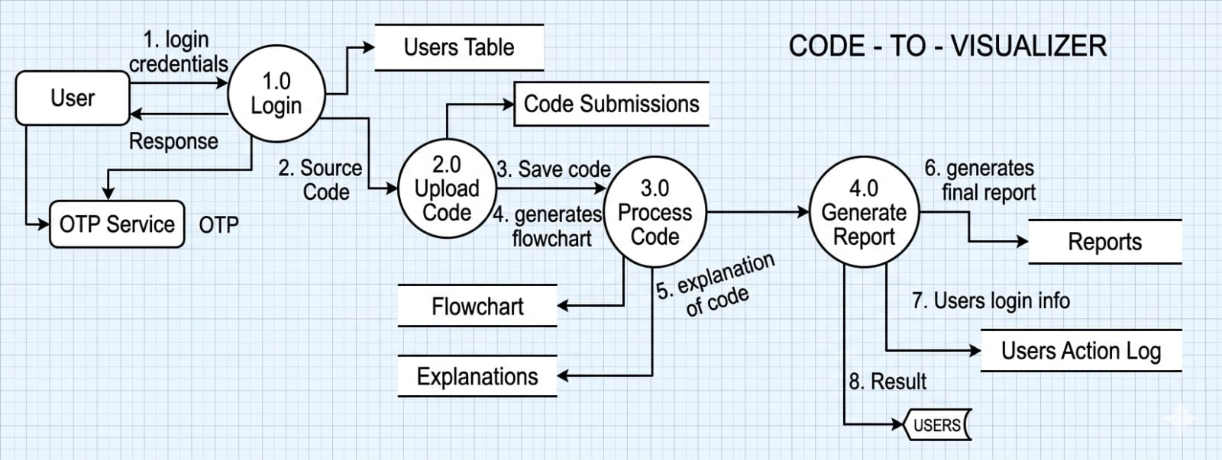
DFD – DATAFLOW DIAGRAM

Slide 9
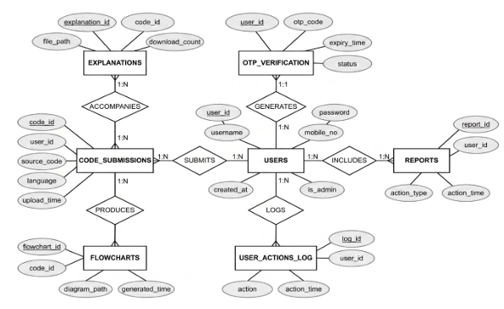
ER-DIAGRAM

Slide 10
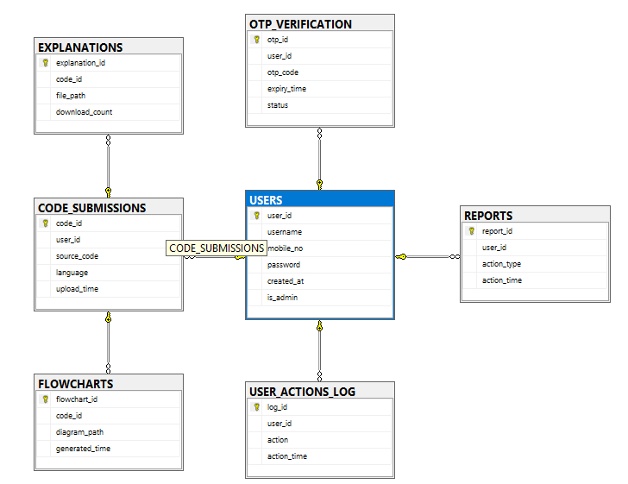
DB-DIAGRAM

Slide 11
Software Specifications
Category |  | Technology
Frontend Framework | : | React via Vite
Backend Framework | : | FastAPI (Python)
Database (Dev) | : | Microsoft SQL Server
Database (Prod) | : | PostgreSQL (Supabase)
JS Execution Runtime | : | Node.js
Flow Rendering | : | React Flow (@xyflow/react)
Graph Auto-Layout | : | Dagre
PNG Export | : | html-to-image
SMS OTP | : | Fast2SMS Phone Auth
Code Encryption | : | cryptography (Fernet/AES-256)
Password Hashing | : | hashlib SHA-256
Deployment (FE) | : | Vercel
Deployment (BE) | : | Railway
Version Control | : | Git / GitHub

Slide 12
Hardware Specifications
Component |  | Minimum Requirements |  | Recommended Requirements
Processor | : | Intel Core i3 / AMD Ryzen 3 | : | Intel Core i5 / AMD Ryzen 5
RAM | : | 4 GB | : | 8 GB or above
Storage | : | 256 GB HDD | : | 512 GB SSD
Network | : | Broadband 1 Mbps | : | Broadband 10 Mbps or higher
Display | : | 1280 × 720 | : | 1920 × 1080 or higher

Slide 13
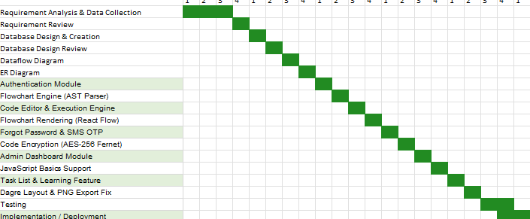
GANTT CHART

Slide 14
CONCLUSION
Successfully developed a system to convert code into flowcharts
Improved code understanding
Integrated authentication and activity tracking
Can be extended for multiple programming languages

